Slide 1



Noida Institute of Engineering and Technology, Greater Noida
Introduction
Unit: 1
Cyber Security
ANC0301
Ms. Swarneema Kumari
Assistant Professor
(IT)
NIET, Gr. Noida
(B Tech IIIrd Sem)

Slide 2
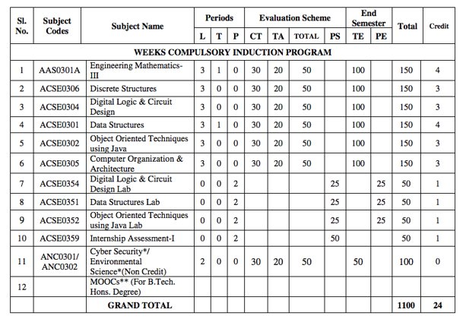








Evaluation Scheme

Slide 3
Syllabus
Introduction:
Introduction to Information Systems: Types of Information Systems, Development of Information Systems, Need for Information Security, Threats to Information Systems, Information Assurance, Guidelines for Secure Password and WI-FI Security and social media and Windows Security, Security Risk Analysis and Risk Management.
Application Layer Security:
Data Security Considerations-Backups, Archival Storage and Disposal of Data, Security Technology-Firewall, Intrusion Detection, Access Control, Security Threats -Viruses, Worms, Trojan Horse, Bombs, Trapdoors, Spoofs, E-mail Viruses, Macro Viruses, Malicious Software, Network and Denial of Services Attack, Security, Threats to E-Commerce: Electronic Payment System, e- Cash, Issues with Credit/Debit Cards.

Slide 4
Syllabus
Secure System Development:
Application Development Security, Architecture & Design, Security Issues in Hardware: Data Storage and Downloadable Devices, Mobile Protection, Security Threats involving in social media, Physical Security of IT Assets, Access Control, CCTV and Intrusion Detection Systems, Backup Security Measures.
Cryptography and Network Security:
Public key cryptography: RSA Public Key Crypto with implementation in Python, Digital Signature Hash Functions, Public Key Distribution.
Symmetric key cryptography: DES (Data Encryption Standard), AES (Advanced Encryption Standard), Secure hash algorithm (SHA-1).
Real World Protocols: Basic Terminologies, VPN, Email Security Certificates, Transport Layer Security, TLS, IP security, DNS Security.

Slide 5
Syllabus
Security Policy:
Policy design Task, WWW Policies, Email based Policies, Policy Revaluation Process-Corporate Policies-Sample Security Policies, Publishing and Notification Requirement of the updated and new Policies.
Recent trends in security.

Slide 6
Branch wise Applications
There are many cyber security real-life examples where financial organizations like banks and social organizations, weather channels etc. have faced cyber-attacks and have lost valuable information and resources. To fix these problems, you'll need comprehensive cyber security awareness.
According to KPMG, the annual compensation for cyber security heads ranges from 2 Cr to 4 Cr annually. The industry also reports a satisfaction level of 68%, making it a mentally and financially satisfying career for most.

Slide 7
Course Objective
Students will learn about :
Security of Information system and Risk factors.
Examine security threats and vulnerability in various scenarios.
Understand concept of cryptography and encryption technique to protect the data from cyber-attack
Provide protection for software and hardware.

Slide 8
Course Outcome
After successful completion of this course student will be able to -
COURSE OUTCOME NO. | COURSE OUTCOMES | Bloom’s Knowledge Level (KL)
CO1 | Analyze the cyber security needs of an organization. | K4
CO2 | Identify and examine software vulnerabilities and security solutions. | K1, K3
CO3 | Comprehend IT Assets security (hardware and Software) and performance indicators. | K2
CO4 | Measure the performance and encoding strategies of security systems. | K3, K5
CO5 | Understand and apply cyber security methods and policies to enhance current scenario security. | K2, K3

Slide 9
Program Outcomes
Engineering knowledge
Problem analysis
Design/development of solutions
Conduct investigations of complex problems
5. Modern tool usage
The engineer and society
Environment and sustainability
Notes:
9

Slide 10
Program Outcomes…(cont.)
8. Ethics
Individual and team work
10. Communication
Project management and finance
Life-long learning
Notes:
10

Slide 11
CO-PO Mapping
CO-PO Mapping
PO No. CO No. | PO1 | PO2 | PO3 | PO4 | PO5 | PO6 | PO7 | PO8 | PO9 | PO10 | PO11 | PO12
CO1 | 2 | 2 | 1 | 2 | - | - | - | 1 | 2 | 1 | 2 | 2
CO2 | 2 | 2 | 2 | 2 | 2 | 1 | - | 1 | 2 | 1 | 2 | 2
CO3 | 2 | 2 | 1 | 2 | 2 | - | - | 1 | 2 | 1 | 2 | 2
CO4 | 2 | 2 | 1 | 2 | 2 | 1 | - | 1 | 2 | 1 | 2 | 2
CO5 | 2 | 2 | 1 | 2 | 2 | - | - | 1 | 2 | 1 | 2 | 2
*3= High *2= Medium *1=Low

Slide 12
Program Specific Outcomes
Program Specific Outcomes (PSOs) are what the students should be able to do at the time of graduation. The PSOs are program specific. PSOs are written by the department offering the program.
On successful completion of B. Tech. (IT) Program, the Information and Technology engineering graduates will be able to:
PSO1 : Work as a software developer, database administrator, tester or networking engineer for providing solutions to the real world and industrial problems.
PSO2 : Apply core subjects of information technology related to data structure and algorithm, software engineering, web technology, operating system, database and networking to solve complex IT problems
PSO3 : Practice multi-disciplinary and modern computing techniques by lifelong learning to establish innovative career
PSO4 : Work in a team or individual to manage projects with ethical concern to be a successful employee
or employer in IT industry.
Notes:
12

Slide 13
CO-PSO Mapping
Program Specific Outcomes and Course Outcomes Mapping
CO | PSO1 | PSO2 | PSO3 | PSO4
CO1 | 2 | 2 | - | 2
CO2 | 2 | 2 | 1 | 2
CO3 | 2 | 2 | - | 2
CO4 | 2 | 2 | - | 2
CO5 | 2 | 2 | - | 2
*3= High *2= Medium *1=Low

Slide 14

Program Educational Objectives
The Program Educational Objectives (PEOs) of an engineering degree program are the statements that describe the expected achievements of graduates in their career, and what the graduates are expected to perform and achieve during the first few years after graduation.
PEO1: To have an excellent scientific and engineering breadth so as to comprehend, analyze, design and solve real-life problems using state-of-the-art technology.
PEO2: To lead a successful career in industries or to pursue higher studies or to understand entrepreneurial endeavors.
PEO3: To effectively bridge the gap between industry and academics through effective communication skill, professional attitude and a desire to learn.
Notes:
14

Slide 15
Result Analysis
Faculty Name | Subject Name | Code | Result
Ms. Swarneema Kumari | Cyber Security | ANC0301

Slide 16
Prerequisite/Recap
Basics recognition in the domain of Computer Science.
Concept of network and operating system.
Commands of programming language.

Slide 17
Introduction
Modern life depends on online services, so having a better understanding of cyber security threats is vital.
The course will improve your online safety in the context of the wider world, introducing concepts like malware, trojan virus, network security, cryptography, identity theft, and risk management.
https://www.javatpoint.com/cyber-security-introduction
https://www.edureka.co/blog/what-is-cybersecurity/
http://natoassociation.ca/a-short-introduction-to-cyber-security/

Slide 18
Content (Unit-1)
Introduction to Information Systems
Types of Information Systems
Development of Information Systems
Introduction to Information Security
Need for Information Security
Threats to Information Systems
Information Assurance
Cyber Security
Guidelines for Secure Password and WI-FI Security and social media and Windows Security
Security Risk Analysis and Risk management

Slide 19
Objective of Topic
Topic | Objective
Information Systems | To Understand the information system , its Types and Development of Information Systems and also understanding of various threats to information system
Information Security | Develop an understanding of information security
Information Assurance | Develop an understanding of information assurance as practiced in computer operating systems
Cyber Security and Security Risk Analysis | Develop an understanding of security policies (confidentiality, integrity and availability), need of cyber security and security risk associated with it.

Slide 20
Topic Mapping with CO
Topic | CO
Introduction to Information Systems | CO1
Types of Information Systems | CO1
Development of Information Systems | CO1
Introduction to Information Security | CO1
Need for Information Security | CO1
Threats to Information Systems | CO1
Information Assurance | CO1
Cyber Security | CO1
Guidelines for Secure Password and WI-FI Security and social media and Windows Security | CO1
Security Risk Analysis and Risk management | CO1

Slide 21
Introduction to Information Systems (CO1)
Information System
Information System is made up of two terms, namely, Information and System.
Information - Well-structured data with a specific meaning
System - an arrangement that takes input and provides output after completing the required process.
“An arrangement that processes data and provides meaningful information.”[1]

Slide 22
Information Systems Cont…
People
Information Systems
Data
Network
Hardware
Software

Slide 23
Information Systems Cont…
An Information system contains software, hardware, data, people, and network.
Processes and essential system elements are also considered as part of an Information System.
An information system (IS) is an organized system for collecting, organizing, storing and communicating with the information.

Slide 24
Fundamental concepts in Information Systems
Capture both internal data and external data of the organization and its environment.
Stores the database items over an extensive period of time.
Based on the user’s need, specifications are deployed.
The output of the Information systems varies on its type.

Slide 25
Types of Information System (CO1)
Information System
Operations Support System
TPS
PCS
Knowledge Based System
MIS
Management Support System
ECS
DSS
EIS

Slide 26
Operations Support Systems (OSS)
Support various business operations such as accounting and production.
Transaction processing system(TPS):
Helps in processing various business transactions and retrieving information from them.
Processing a transaction can be done in two ways -
Batch Processing
Online or Real-time processing.
Batch Processing - transactions are stored over a period of time and then processed.
Real-Time Processing – transactions are processed during their occurrences. For example, at retail stores, the cash receipts or card payments are registered and processed simultaneously.

Slide 27
Operations Support Systems (OSS)
B- Process Control System (PCS)
Monitoring and controlling physical processes basically in production Industries.
Example-
Making day-to-day decisions
Controlling operational processes.
This system automates the adjustment of a production process.

Slide 28
Operations Support Systems (OOS)
C- Enterprise collaboration system (ECS)
Helps in sharing information among employees.
A proper flow of information helps in increasing the productivity of an organization.
Example of Tools used in ECS-
Mails
Video Conferencing
Group calendars

Slide 29
Knowledge-Based Systems
Provides information to users in different business areas when required.
Expert system: Provides adequate knowledge and expert advice for making various managerial decisions.
Expert System = Knowledge base + Software modules
Knowledge Management System (KMS): For sharing knowledge, KMS uses a group of collaboration systems, such as the Intranet. Provides two types of knowledge-
Explicit knowledge - Information that is documented, stored, and coded with the help of an Information System.
Implicit/Tacit knowledge - Information based on processes and procedures stored in the human mind.

Slide 30
Management Support Systems
MSS provides useful information to managers for decision making and control.
Management Information System (MIS): It generates information for monitoring performance and maintaining coordination.
Example- Production manager can check the report of cost and time of production.

Slide 31
Management Support Systems
b) Decision Support System (DSS):
Supports managerial decision making. Example -Sales manager can set sales targets for the coming year by considering the existing market conditions.
Executive Information System (EIS) or Executive Support System (ESS) :
Provides critical information to the executive and top-level managers for for making strategic decisions.

Slide 32
Recap
Information System:
An arrangement that processes data and provides meaningful information.
Types of Information System
Operations Support System
TPS
PCS
ECS
Knowledge Based System
Management Support System
MIS
DSS.

Slide 33
Development of IS (CO1)
Development of IS, similar to the application development procedure.
The main approaches are listed as follows:
Waterfall model
Prototyping model
Evolutionary model
Spiral model
Incremental model

Slide 34
Waterfall model
This method is also called linear sequential model.
Feasibility Check
Requirement Enquiry
Design
Coding
Testing
Maintenance

Slide 35
Stages of Waterfall Model
Feasibility check: Technical and financial feasibility check about system development.
Requirement and specifications: Gathering knowledge about the required system and developing the specifications needed.
Design: Converting the requirements and specifications into a system model.
Coding: Coding is the process of designing a bridge between the understanding of the user and the system. This is also called programming.
Testing: Ensuring that the system performance is according to the user requirements. This is done after a system is set for use.
Maintenance: Changes in the system after testing or use to correct the shortcomings or further requirements.

Slide 36
Drawbacks of Waterfall Model
It approaches feasibility analysis before requirement analysis, which is not practical.
It tests the system after implementing and designing; therefore, any change required after testing can be hard to be introduced.
Any feedback to the previous process has not been approached.

Slide 37
Prototyping Model
The prototype may be a usable program but is not suitable as the final software product.
The code for the prototype is thrown away. However, experience gathered helps in developing the actual system.
The development of a prototype might involve extra cost, but overall cost might turnout to be lower than that of an equivalent system developed using the waterfall model.

Slide 38
Prototyping Model
Rapid Prototype
Changed Requirements
Analysis
Design
Implementation
Development
Maintenance
Postdelivery maintenance
Retirement

Slide 39
Evolutionary Model
Evolutionary model approaches to improve the classic waterfall model by providing scope of feedback and improvement at every stage of the system development.
Therefore, every stage should be taken as a separate evolutionary phase.
This model is useful for complex projects where all functionality must be delivered at one time, but the requirements are unstable or not well understood at the beginning.

Slide 40
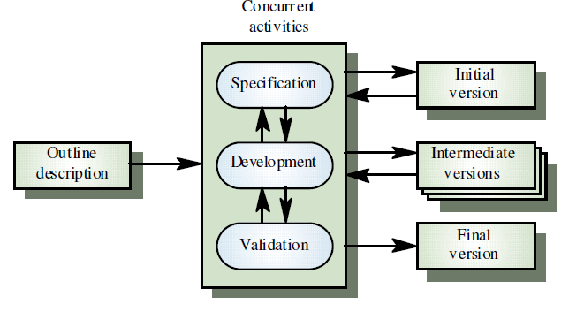
Evolutionary Model
Source: software engineering k k aggarwal

Slide 41
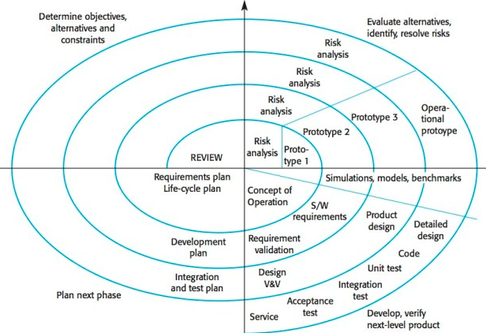
Spiral Model
It is a combination of the features of the waterfall and prototype models.
This idea was given by Boehm.
Source: Software engineering K K Aggarwal

Slide 42
Stages of Spiral Model
User/client communication: Interaction with the client or users of the system to identify the requirements and specifications in the system
System planning: Planning the system to be developed and preparing a rough draft and schedule of the development process
Risk analysis: Identifying the problems in the plan and developing solutions to check them
Engineering: Involves system hardware and software design, coding and testing the system
Construction and finalization: Involves system building and testing to release it for use
System evaluation: Evaluation by user or client to use the system.
Note- All these phases are repeated in the process of system development until users approve the system.

Slide 43
Incremental Model
Incremental model approaches system development through various incremental steps, where every step tries to add more functions in the system development process.
Each step of system development is a separate group of activities.
This model can also be called Continuous Improvement Model.

Slide 44
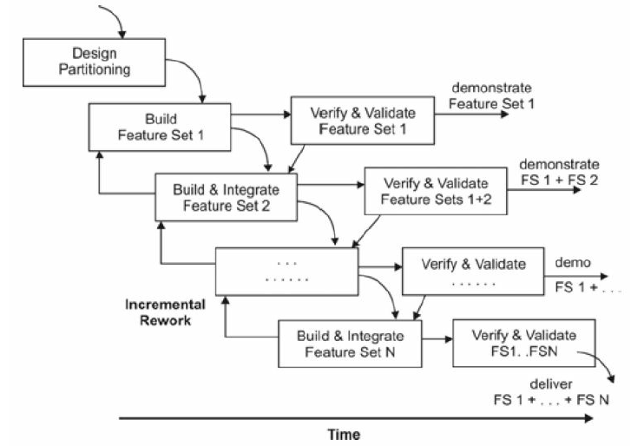
Incremental Model
Source: software engineering k k aggarwal

Slide 45
Recap
Development of Information System:
Waterfall model
Prototyping model
Evolutionary model
Spiral model
Incremental model

Slide 46

Introduction to Information Security (CO1)
Information security refers to the protection of information.
It is the process of securing, protecting, and safeguarding the information from an unauthorized access, use, and modification.
Information is an important part of an organization or a business that requires more attention to preserve its integrity, privacy, and availability.
Goals of information security -
Confidentiality
Integrity
Availability
Source: Swayam

Slide 47
Introduction to Information Security
Process of securing information from unauthorized access
Integrity
On time
Fault tolerance exists in the computer system or network
Fair allocation of resources over the network
Concurrency control management in database
Deadlock management in database
Confidentiality
Integrity
Availability
Securing the information from unauthorized modification.

Slide 48

Need for Information Security (CO1)
To maintain proper security of information in an organization, we need to apply certain measures, policies, and procedures so that no harm is caused to the confidentiality, integrity, and availability of organizational information.
Data breaches are become common
Shrinking time from exposure to attack
Epidemic of security vulnerabilities
Phishing and spamming
Zero day attack
Source: Swayam

Slide 49
Task to do
Zero day attack
A zero-day attack is a software-related attack that exploits a weakness that a vendor or developer was unaware of. The name comes from the number of days a software developer has known about the problem. The solution to fixing a zero-day attack is known as a software patch.

Slide 50
Threats to Information Systems (CO1)
A threat is an illegal activity that can cause damages such as loss of information and data corruption to the network of an organization.
The hardware and software components of a computer system are highly vulnerable to many threats.
Types of Threat
Accidental threat
occur due to exposure of confidential information and unauthorized modification in information.
occurrence is not dependent on any entity
Intentional threat
It is performed by an entity to violate security of the computer system and network.

Slide 51
Attacks on the Network
Attacks on the network can breach the security of data and resources over the network.
Attacks
Passive
Release of the message Content
Traffic Analysis
Active
Masquerade
Replay
Modification of Message
Denial of Service

Slide 52
Passive Attack
The attacker does not intend to cause any harm to the network.
The attacker observes the information for which he/she does not have access rights.
Only Monitors, analyzes, or observes the information available over the network.

Slide 53
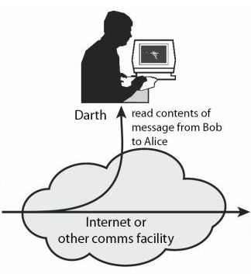
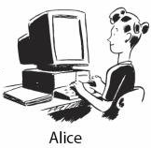
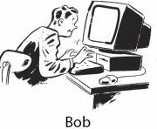
Passive Attack
Release of the message Content
Source: cryptography and network security william stallings

Slide 54
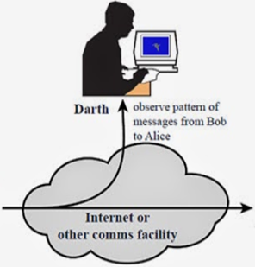
Passive Attack
Traffic Analysis
Source: cryptography and network security william stallings

Slide 55
Active Attack
Intentions can be wrong.
The attacker tries to steal information from the network.
Attacker can create, delete, modify, and replace a message.

Slide 56
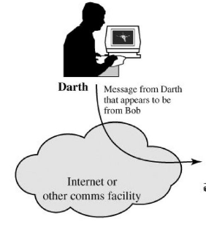
Active Attack
Masquerade
Source: cryptography and network security william stallings

Slide 57
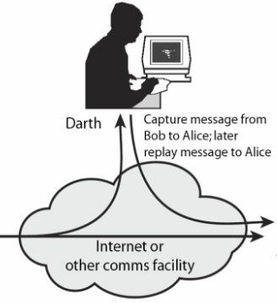
Active Attack
Replay
Source: cryptography and network security william stallings

Slide 58
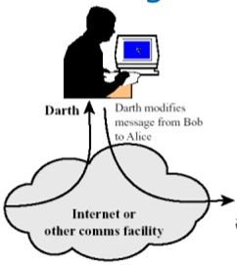
Active Attack
Modification of Message
Source: cryptography and network security william stallings

Slide 59

Active Attack
Denial of Service
Controller
Handlers
Attack Bots
Target

Slide 60
Recap
Information Security:
Confidentiality
Integrity
Availability
Attacks
Passive
Release of the message Content
Traffic Analysis
Active
Masquerade
Replay
Modification of Message
Denial of Service

Slide 61
Information Assurance (IA) (C01)
IA is defined as the set of measures applied to protect information systems and the information of an organization.
It ensures availability, integrity, authentication, confidentiality, and non-repudiation of an organization’s information and IS.

Slide 62
IA vs IS
Information Assurance
Information Security
Focuses mainly on strategy
Covers information management and protection in a larger domain
Keeps focus on the overall risk management for the security of an organization
Focuses primarily on tools and tactics
Gives importance and priority to technology.
Concentrates on applications and infrastructure developed to provide security and operations.

Slide 63

Information Security
It protects information from unauthorized access
Helps to avoid identity theft
Promotes Information privacy
Major techniques used are
Identification, Authentication and authorization of users
Cryptographic techniques
Source: Swayam

Slide 64
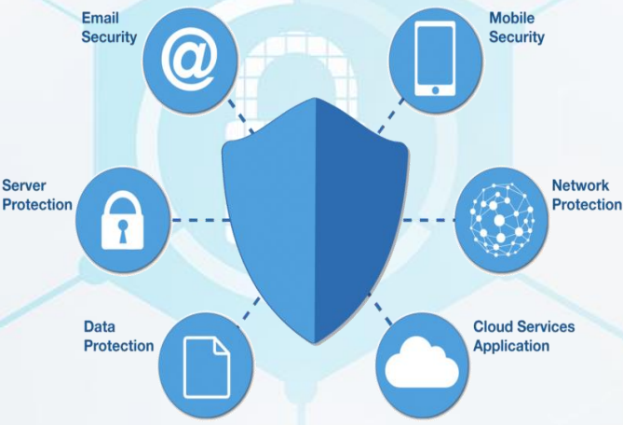
Network Security
It identifies threats and stops them from entering or spreading into the network
Network security components include:
•Anti-virus and anti-spyware
•Firewall
•Intrusion prevention systems (IPS)
•Virtual Private Networks (VPNs)
Source: Swayam

Slide 65
Security services
Authentication– verifies the identity of the user
Authorization– grants permission to authorized users
Auditing– Increases the system competence
Non-repudiation– The assurance that someone cannot deny the validity of something.

Slide 66
Guidelines for Secure Password and WI-FI Security and social media and Windows Security
The following are general recommendations for creating a Strong Password:
A Strong Password should -Be at least 8 characters in length
Contain both upper and lowercase alphabetic characters (e.g. A-Z, a-z)
Have at least one numerical character (e.g. 0-9)
Have at least one special character (e.g. ~!@#$%^&*()_-+=)
A Strong Password should not -Spell a word or series of words that can be found in a standard dictionary
Spell a word with a number added to the beginning and the end
Be not based on any personal information such as user id, family name, pet, birthday, etc.

Slide 67
Guidelines for Secure Password and WI-FI Security and social media and Windows Security
How To Set Your Wi-Fi Security Protocols
Type your router’s IP address in a web browser’s search bar.
Enter your router’s username and password.
Go to Wireless Security. This tab or page may be called something else in your router.
Select a security protocol.
Here is a list of the security protocols ranked from the most secure to least secure:
WPAWPA2-PSK (TKIP/AES) – Most secure option, but not available on most routers
WPA2-PSK (AES) – Most secure option for most routers
WPA2-PSK (TKIP) – Still usable, minimal security
WPA-PSK (AES) – Still usable, minimal security
WPA-PSK (TKIP) – Not very secure
WEP 128 – Risky
WEP 64 – Highly risky
Open network or no passcode at all – No security
WPA2 and AES are the best settings to secure your Wi-Fi connection from hackers. If hackers are able to breach your network, they could steal important information, like bank details, or even your identity.

Slide 68
Guidelines for Secure Password and WI-FI Security and social media and Windows Security
Social networking sites like Facebook and Twitter can be a great way to connect with friends. But there are some social networking safety tips you should always keep in mind.
Manage your privacy settings. Learn about and use the privacy and security settings on your social networking sites. They help you control who sees what you post and manage your online experience in a positive way. You'll find some information about Facebook privacy settings at the bottom of this webpage.
Remember: once posted, always posted. Protect your reputation on social networks. What you post online stays online. Think twice before posting pictures you wouldn't want your parents or future employers to see. Recent research found that 70% of job recruiters rejected candidates based on information they found online.
Build a positive online reputation. Recent research also found that recruiters respond to a strong, positive personal brand online. So demonstrate your mastery of the environment and showcase your talents.

Slide 69
Guidelines for Secure Password and WI-FI Security and social media and Windows Security
Keep personal info personal. Be careful how much personal info you provide on social networking sites. The more information you post, the easier it may be for someone to use that information to steal your identity, access your data, or commit other crimes such as stalking.
Protect your computer. Security start with protecting your computer. Install Antivirus software. Keep your operating system, web browser, and other software current. You can use the Pitt Software Update Service to automatically download the latest security updates for Windows.
Know what action to take. If someone is harassing or threatening you, remove them from your friends list, block them, and report them to the site administrator.
Use strong passwords. Make sure that your password is at least eight characters long and consists of some combination of letters, numbers, and special characters (for example, +, @, #, or $).
Be cautious on social networking sites. Even links that look they come from friends can sometimes contain harmful software or be part of a phishing attack. If you are at all suspicious, don't click it. Contact your friend to verify the validity of the link first.

Slide 70
Guidelines for Secure Password and WI-FI Security and social media and Windows Security
1. Disable Windows 10 automatic login.
2. Set a password with your screensaver.
3. Turn on your firewall.
4. Disable remote access.
5. Enable or install antivirus protection tools.
6. Enable auto-updates for your operating system.
7. Set up file backups.
8. Turn on encryption.
9. Set up your user accounts.
10. Set up a password manager.

Slide 71
Contrasting Internet & Cyberspace
Cyberspace
It is a symbolic and figurative space that exists within Internet
It supports multitude of business, government and social interactions through information exchange
Internet
The design of Internet results in a cyberspace built out of components
It provides services designed to form more complex services

Slide 72
Security Risk Analysis(CO1)
The entire process of maintaining organizational security involves assessment, analysis, and management of risks.
Assessment is identification of any potential risks for a system.
Analysis means measuring the effects that may be caused to the system and providing details to the management team for taking steps that will counter the most concerning issues.

Slide 73
Security Risk Analysis
Management of risks is to take appropriate steps for removing system vulnerabilities. (Covered this in starting of unit)
Risk analysis is a continuous process that requires you to constantly monitor the measures employed to maintain security of your systems at present.
Keep calculating threats evaluating their further effects.
It keeps the economy in check, that is, the cost of applied security measures never exceed the possible losses.

Slide 74
Risk analysis terminology
Assets:
Everything that has some value and needs to be safeguarded.
Threats:
possible danger to assets
Vulnerabilities:
any weakness/flaw in the system
Countermeasures:
Countermeasures are the devices or actions with an intent and capability to reduce system vulnerabilities.
Expected losses:
expected impacts of threats on an organization’s assets
Impact:
It is usually categorized into four areas, namely, destruction, disclosure, modification, and Denial of Service (DoS).

Slide 75
Key Elements of Risk Analysis
Impact statement: The impact statement describes the damages that may be caused by threats.
Effectiveness measure: The effectiveness measure presents the calculated effectiveness of individual actions taken to counter the impact of threats.
Recommended counter measures: The recommended countermeasures involve possible actions that are cost effective and maintain security of assets in a proper manner.

Slide 76
Risk Management
Cyber Services - Cyber security is crucial. RCS methods keep you secure while identifying & eliminating threats from cyber criminals.
Investigation - RCS knows how to perform discreet, effective, and fully legal investigations for both individuals and organizations.
Security Consulting - RCS identifies and mitigates risks and vulnerabilities. If a problem arises, risk level is determined and action is taken.
Business Intelligence - RCS business intelligence capabilities safeguard your assets & intellectual property from internal & external threats.

Slide 77
Daily Quiz
What is Cyberspace?
Difference between Information Security and Information assurance
Differentiate Information Security and cyber security.
What is the CIA Triad?
What are the Tools used for Cyber Security?
Differentiate Cyberspace and Internet.

Slide 78
Weekly Assignment
What do you mean by Information System? What is the need of Information System?
What are the types of Information System?
Explain Confidentiality, Integrity and Availability in terms of cyber security
What is the need to secure our Information System?
Explain the different Threats to Information System?
What do you understand by Information system failure?
What is Cyber Security and How it is different from Information Security?
What is information assurance and how is it provided?
Describe security risk and analysis?
Define all possible cyber-attacks and write the difference between active cyber-attack and passive cyber attack.

Slide 79
Faculty Video Links, Youtube & NPTEL Video Links and Online Courses Details
https://youtu.be/BvWvFAS1iP0?list=PLUtfVcb-iqn834VGI9faVXGIGSDXZMGp8
https://youtu.be/ooJSgsB5fIE
https://youtu.be/tff_X0BMgfk
https://youtu.be/fQ3ESFfvchg?list=PLUtfVcb-iqn834VGI9faVXGIGSDXZMGp8
https://swayam.gov.in/nd2_cec20_cs09/preview
https://www.youtube.com/watch?v=sdpxddDzXfE
https://www.youtube.com/watch?v=0p3787JiFgQ
https://www.youtube.com/watch?v=JdfmV2KW11I

Slide 80
MCQ s
Cyber security is related to:
a.Viruses, phishing, and identity theft
b. Protection for applications and individual privacy
c. Protection from online predators and cyber bullies
d. All of the above
Mention the key factor in determining the strategic business advantage.
a. Security
b. Information system
c. Information integrity
d. knowledge
Which of the following is created by human for virtual interactions and exchanges?
a. Computer
b. Cyberspace
c. Mobile phones
d. All the above

Slide 81
MCQ s
Which indicates the basic weakness in a system?
a. Threat
b. Attack
c. Vulnerability
c. Risk
Which of the following is not a type of attack on the network?
a. Active attack
b. Passive attack
c. Neutral attack
d. All of the above
Security risk includes the following element(s):
a. Impact statement
b. Effectiveness measure
c. Recommended countermeasures
d. All of the above

Slide 82
MCQ s
Which of the following is the primary focus of information assurance is:
a. Strategy
b. Tools
c. Infrastructure security
d. None of the above
Which of the following is not a type of information system?
a. Operations support systems
b. Knowledge-based systems
c. Employment systems
d. Management support systems
Operations support system involves:
a. Transaction processing system
b. Process control system
c. Enterprise collaboration system
d. All of the above

Slide 83
Glossary Questions
Ques 1. Define the term data and information. Explain Information system.
Ques 2. Explain contributing factors for insecure system in detail.
Ques 3. Explain issues related to information systems in cyber security.
Ques 4. Explain six basic security principles.
Ques 5. Explain six different kind of Information System.

Slide 84
Glossary Questions
Ques 6. Explain different types of methodologies for development of information system.
Ques 7. Why the information security is needed?
Ques 8. Explain Information Assurance.
Ques 9. Explain Security Risk Analysis in detail.
Ques 10. Explain the steps of involved in the process of risk management.

Slide 85
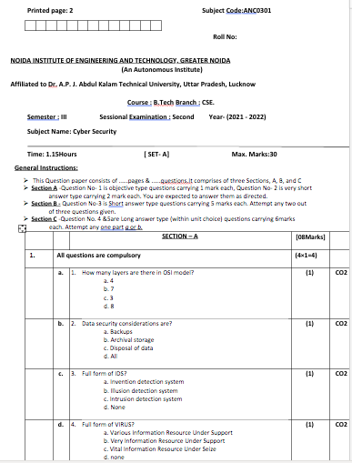
Past Sessional Papers

Slide 86
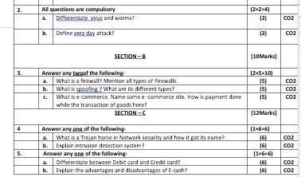
Past Sessional Papers

Slide 87
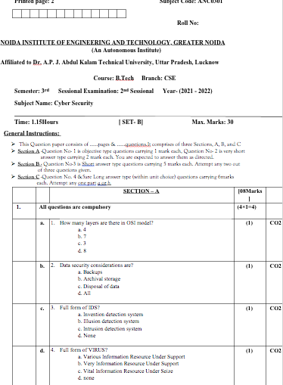
Past Sessional Papers

Slide 88
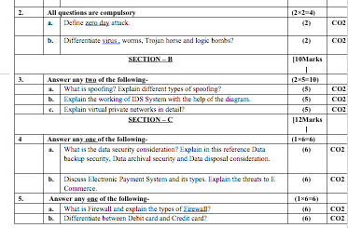
Past Sessional Papers

Slide 89
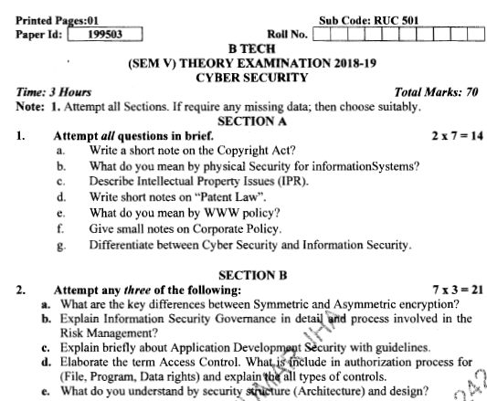
Old Question Papers

Slide 90
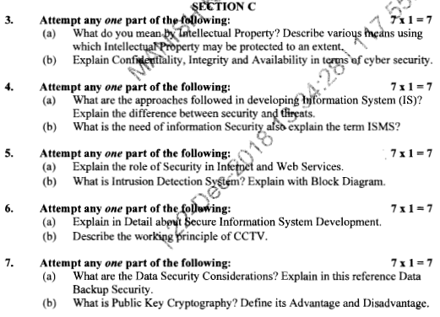
Old Question Papers

Slide 91
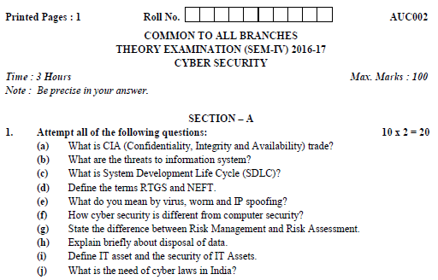
Old Question Papers

Slide 92
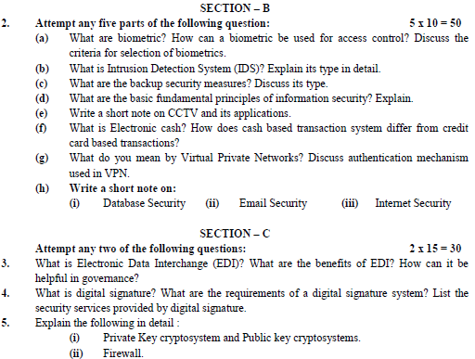
Old Question Papers

Slide 93
Expected Questions for University Exam
Compare cyber security, information security, Information assurance.
Differentiate Cyber space and Internet.
Explain man-in-the –middle attack.
Explain scope of information assurance
What is decision support system
Explain the term vulnerability and threats. How these are related?

Slide 94
Recap
Information Systems have become integral part of any systems
Every fraction of a second, lot of information is exchanged and the strong information system framework support is necessary.
Hence, this module has discussed about all the security measures, principles needed to preserve Information security

Slide 95
Summary
In this digital era when everything is accessed and operated through cyber space, security is the very important feature. To understand the need for cyber security, different incidents and statistical reports are presented. Lack of security may lead to setbacks in financial matters, personal and professional operations. Important terms related to Cyber Security are also discussed in this module. Different types of Cyber threats, the methods of Cyber Attacks are also explained. The four important fundamentals of security and the other essentials in securing the computers are also explored to understand the basic operations in cyberspace.
Cyber security is a broader term which protects all the hardware (devices, routers, and switches), software, information, and data that are part of the cyber space. Cyber Security cannot be misguided with data security.

Slide 96
References
Charles P. Pfleeger, Shari Lawerance Pfleeger, “Analysing Computer Security ”, Pearson Education India.
V.K. Pachghare, “Cryptography and information Security”, PHI Learning Private Limited, Delhi India.
Dr. Surya Prakash Tripathi, Ritendra Goyal, Praveen kumar Shukla ,”Introduction to Information Security and Cyber Law” Willey Dreamtech Press.(prefer)

Slide 97
Thank You

